Slide 1

Mimic: UI Compatibility Testing System for Android Apps
Taeyeon Ki*, Chang Min Park, Karthik Dantu, Steven Y. Ko, and Lukasz Ziarek
University at Buffalo, The State University of New York

Slide 2
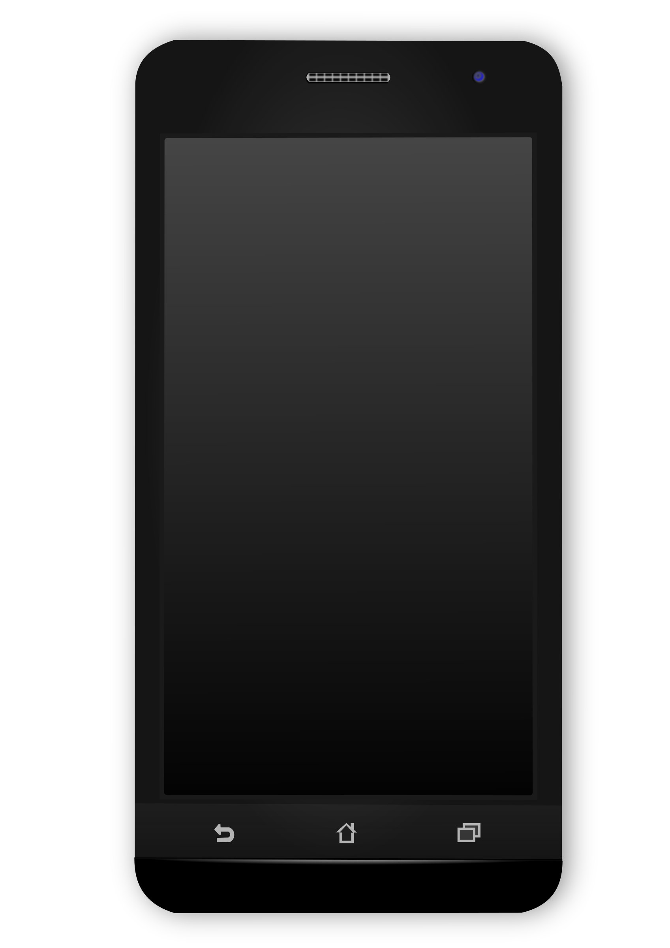
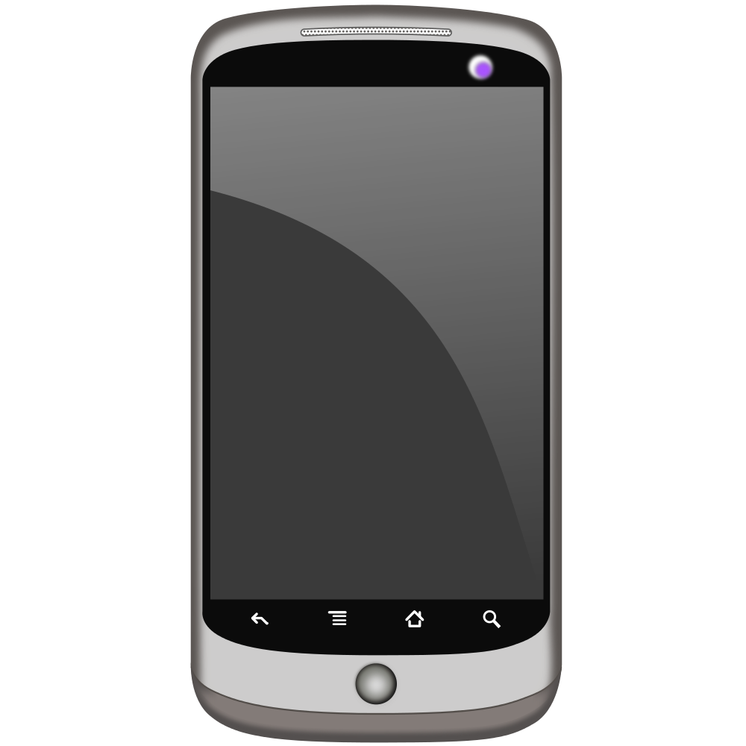
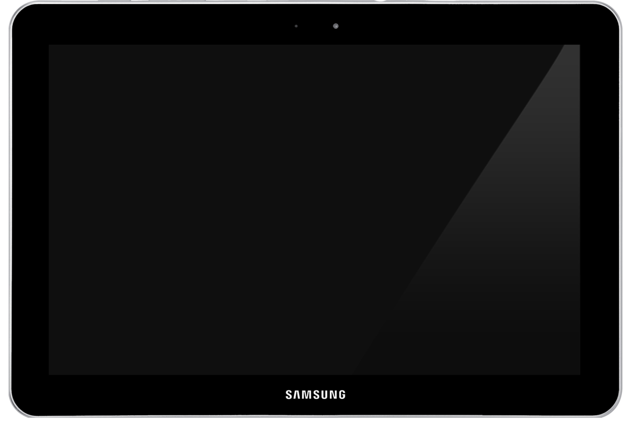



What Do We Mean by UI Compatibility Testing?
Compares UI behavior in heterogeneous environments
Three types of heterogeneity
1. Different Android API versions
2. Different app versions
3. Different devices
v1.0
v2.0
v3.0

Slide 3


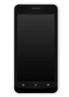
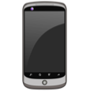
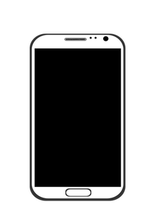

Why is UI Compatibility Testing Important?
App behaviors are different for each heterogeneity type.
Different Android API Versions
An app can behave differently across different API versions.
API 28
API 27
API 26
API 25
Different App Versions
v1
v2
v3
Any new feature & modification
Update on third-party UI libraries
Different Devices
Different performance specs
Different screen sizes and resolutions

Slide 4



How Do Testers Use Current Testing Systems?
- For example, testers implement random testing across different Android API versions
(UI element is randomly selected and tested)
Manual Device Management
Testers manually install different Android platforms and application.
Testers monitor device status and capture logs.
Implementation
API 28
API 27
API 26
API 25
Testers implement their testing strategy using a testing framework
e.g., implementing random testing using Android’s testing framework.
While Testing
Testers manually check how different UI screens are transitioning.
Testers manually check the appearance of each UI screen.
After Done with Testing
Testers analyze collected logs.
API 24
API 23
API 22
API 21

Slide 5
Requirements of UI Compatibility Testing
1. Automated device management – reduces burden of manual tasks
(e.g., setting monitoring status)
2. Programmability – makes testing strategy implementation easier (e.g., random, etc.)
3. Comparison of UI behavior – How UI transitions are different
4. Comparison of UI appearance – How actual device screens are different
No previous UI compatibility testing system

Slide 6
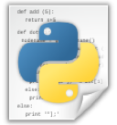
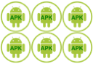
Mimic System Overview
Mimic Runtime
Device Controller
Testing Engine
Mimic script
Graph Generator
Visual Inspector
Apps

Slide 7
Mimic System Overview
Mimic Runtime
Device Controller
Testing Engine
Mimic script
Graph Generator
Visual Inspector
Apps

Slide 8
Environment Setting
Device Controller (1st Requirement - Automated Device Management)
Supports automated environment setting and device management
Device Management
Reads settings from a script
Installs specific versions of the Android platform and the application
Monitors device status
Captures all logs
Device Controller
Mimic script
Automated !
APK set

Slide 9
Mimic System Overview
Mimic Runtime
Device Controller
Testing Engine
Mimic script
Graph Generator
Visual Inspector
Apps

Slide 10


UI Behavior Comparison – Across Different Devices and Versions
We need to test the exact same sequence of UI actions.
A Current Model: Individual Random Testing
It is a common type of testing.
Each device tests UI elements individually.
A sequence of UI action is different on each device.
It is difficult to compare UI behavior across different devices.
Not suitable for UI compatibility testing

Slide 11
UI Behavior Comparison – Across Different Devices and Versions
We need to test the exact same sequence of UI actions.
We Propose “Follow-the-Leader” Testing
Leader
The leader tests a UI element and informs followers.
Followers test the same UI element.
A sequence of UI elements is always same across all the devices.
Followers
Suitable for UI compatibility testing

Slide 12
Programmability (2nd Requirement)
Testers should be able to implement multiple strategies easily.
(e.g., random testing, sequential testing)
Screen
Example Strategies:
Random and Sequential Testing
UI
UI
UI
Randomly selects a UI element and tests it
Repeats until a timeout occurs
Screen
UI
UI

Slide 13
Programmability (2nd Requirement)
Testers should be able to implement multiple strategies easily.
(e.g., random testing, sequential testing)
Screen
Example Strategies:
Random and Sequential Testing
UI
UI
UI
Iterates all UI elements
Ends when there is no UI element to test
Tests all UI elements before moving on to next screen
Screen
UI
UI

Slide 14
Programmability (2nd Requirement)
Testers should be able to implement multiple strategies easily.
(e.g., random testing, sequential testing)
Screen
Example Strategies:
Random and Sequential Testing
UI
UI
UI
Testers should be able to do the following
Detecting when a new screen comes up
Determining a set of UI elements to test
Interacting with the UI elements
Screen
UI
UI

Slide 15
Our Programming Model
Enables testers to implement a testing strategy using two callbacks
UITree onUITreeChanged (UITree tree)
UI Tree
It is called whenever a new screen comes up.
It passes a UITree to the testers.
Testers need to implement the selection of UI elements to test and return the selected UI elements. (e.g., returning a random UI element)
Set of UI elements for specific screen
Each UI has information if it has been tested
Connected with previous and next UI trees
Screen 1
Screen 2
UI 1
void handleNextUIObject (UIObject ui)
UI 2
UI 3
It is called for each UI element from the set returned by onUITreeChanged.
It passes a UIObject to the testers.
Testers need to implement what to do with the UI Object. (e.g., clicking the UI object, swiping, etc.)
UI tree
UI tree

Slide 16
Programming Model (cont.)
Example Implementation - Random Testing
1
2
3
4
5
6
def onUITreeChanged(UITree):
return tree.sortUIElements(sortType="random")
def handleNextUIObject(ui):
if ui.clickable:
ui.click()
Can be implemented with 5 lines of code
(excluding configuration)

Slide 17
Programming Model (cont.)
Status of UI Tree and UI elements
Device controls
UITree previousUITree
bool completedTest
int loadingTime
bool contains (**kwargs)
UIObject select (**kwargs)
UITree sortUIElements (sortType)
DeviceInfo info () | void terminate (msg)
void attach (serial) | void detach (serial)
void screenshot (fileName)
Event handlers
UI controls
UITree onUITreeChanged (UITree tree)
void handleNextUIObject (UIObject ui)
void onBatteryChanged (Battery battery)
void onHeapUsageChanged (Heap heap)
void onTestingTimeChanged (TestingTime time)
void click () | void longClick ()
void drag (x,y) | void swipe (direction)
void press (buttonName)
void wait (time)
bool contains (** kwargs)

Slide 18
Mimic System Overview
Mimic Runtime
Device Controller
Testing Engine
Mimic script
Graph Generator
Visual Inspector
Apps

Slide 19
Graph Generator (3rd Requirement – Comparison of UI Behaviors)
Graph
Shows all UI transitions of an app
Contains a status of each UI element – ‘tested ’, ‘not tested’, or ‘not available’
Gets generated for each device
Why do we need a “graph”?
By looking at graphs from a leader and followers,
Can compare all UI transitions
Can check which UI elements have been tested

Slide 20
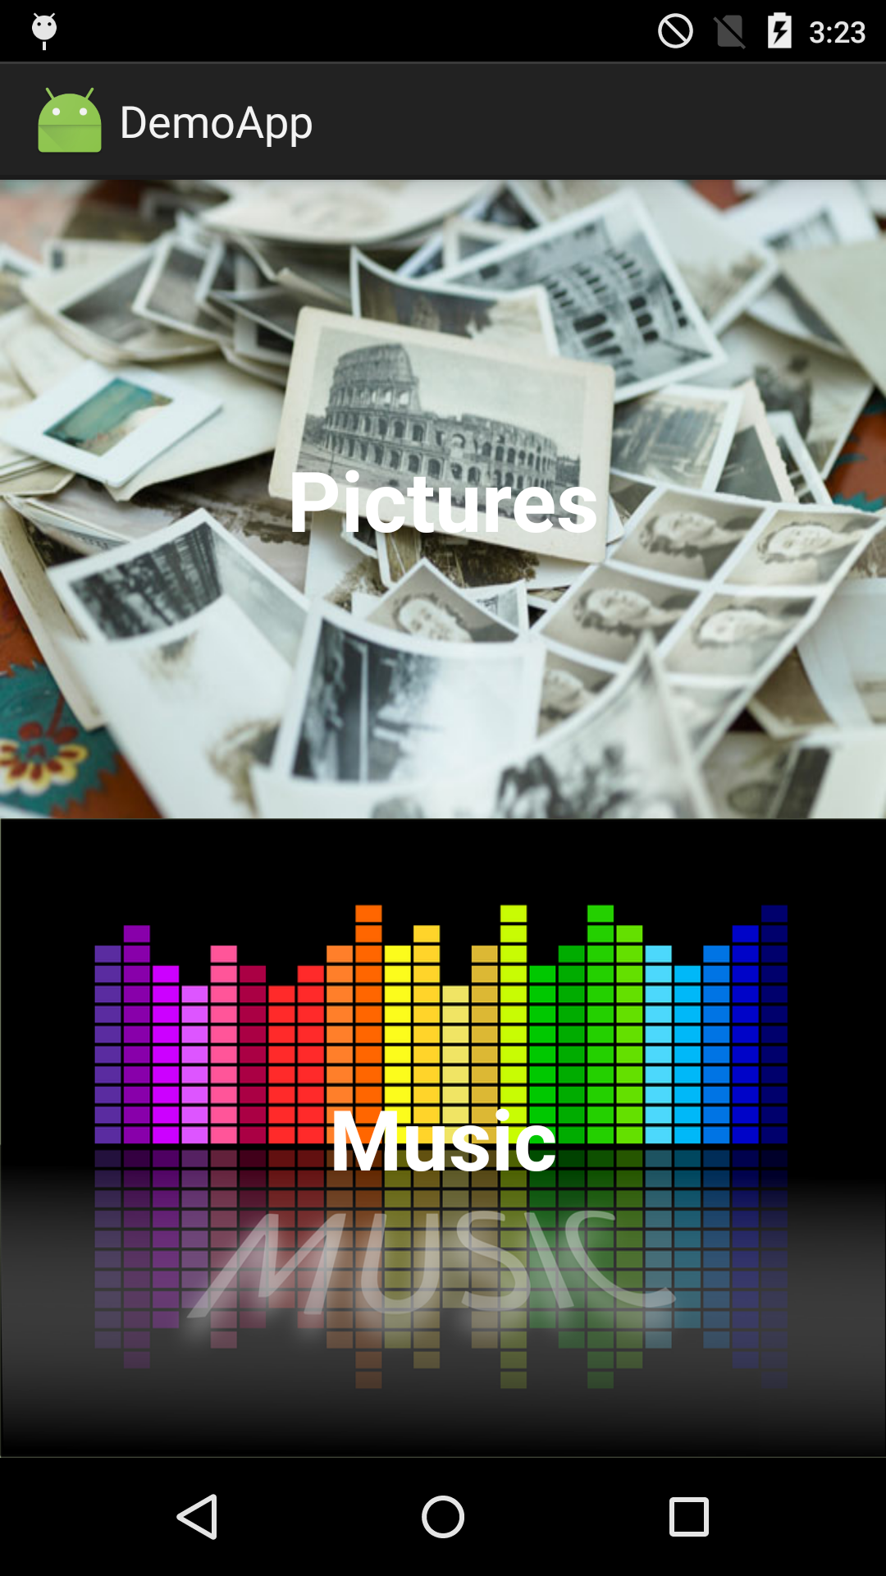
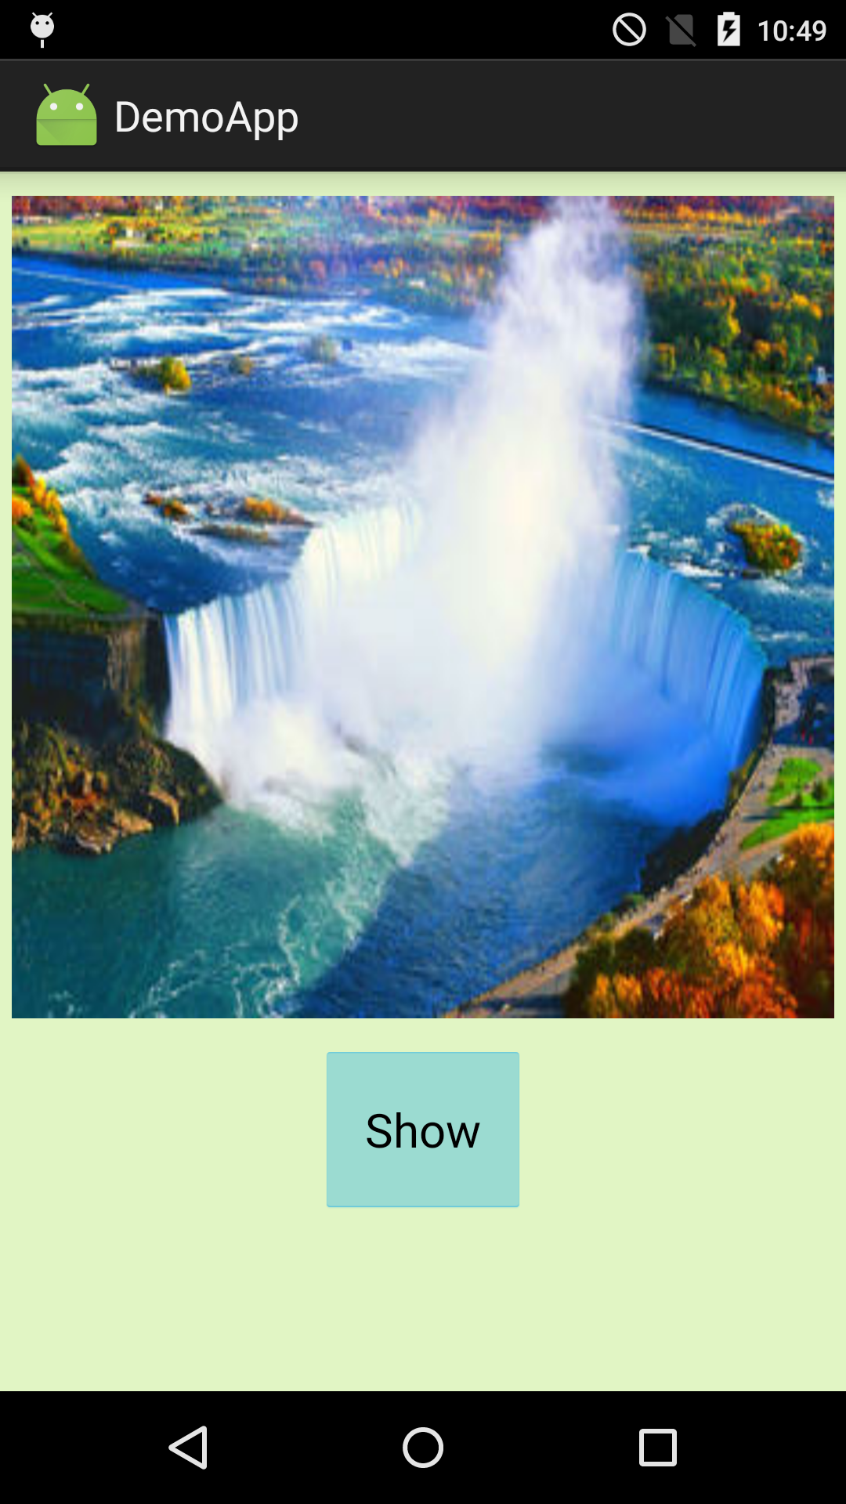
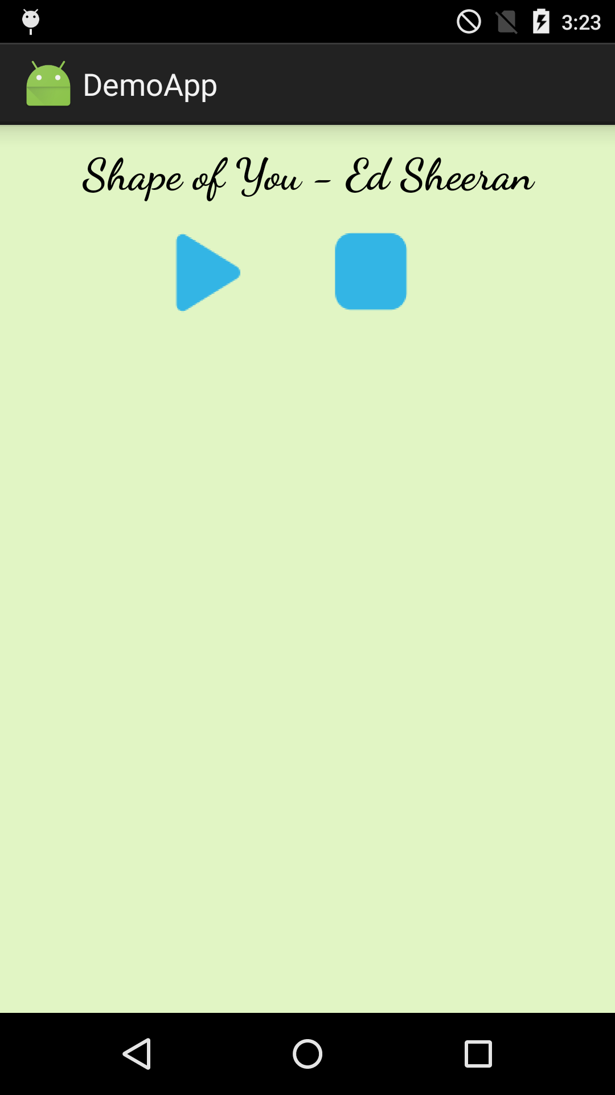
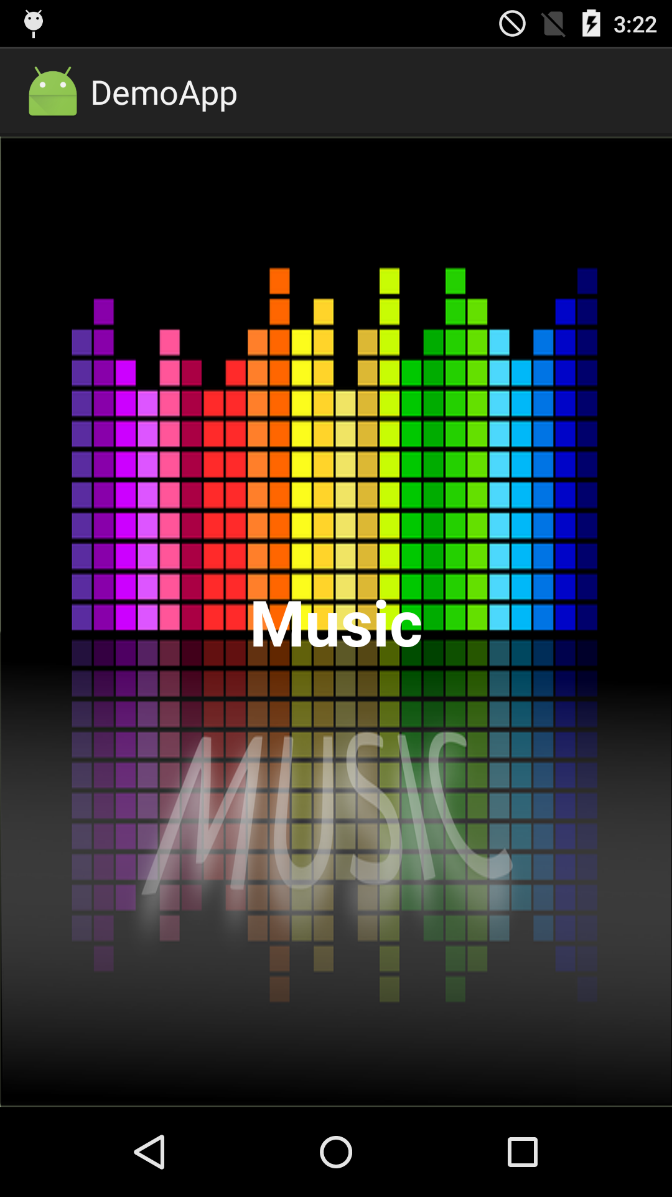

Graph Generation
Main Screen
Pictures Screen
Music Screen
Main Screen
Music Screen
Graph generation on DemoApp
DemoApp v1.0 (leader)
DemoApp v1.1 (follower)
Main Screen
Main Screen
Pictures
Music
Pictures
Music
Music
Pictures
Music
Pictures Screen
Music Screen
Pictures Screen
Music Screen
Play
Stop
Play
Stop
Show
Play
Stop
Play
Stop
Show
Show
Fig. Graph of DemoApp v1.0
Fig. Graph of DemoApp v1.1

Slide 21
Mimic System Overview
Mimic Runtime
Device Controller
Testing Engine
Mimic script
Graph Generator
Visual Inspector
Apps

Slide 22
Visual Inspector (4th requirement – Comparison of UI appearance)
Compares UI appearances across different devices
Different devices may have unexpected differences – e.g., UI distortion and misposition
Requires a computation to capture the differences
How it works
Takes screenshots on leader and follower devices
Masks the top status bar and the bottom navigation bar
Computes the difference between the screenshots using:
Color Histogram & Feature Matching (OpenCV)

Slide 23
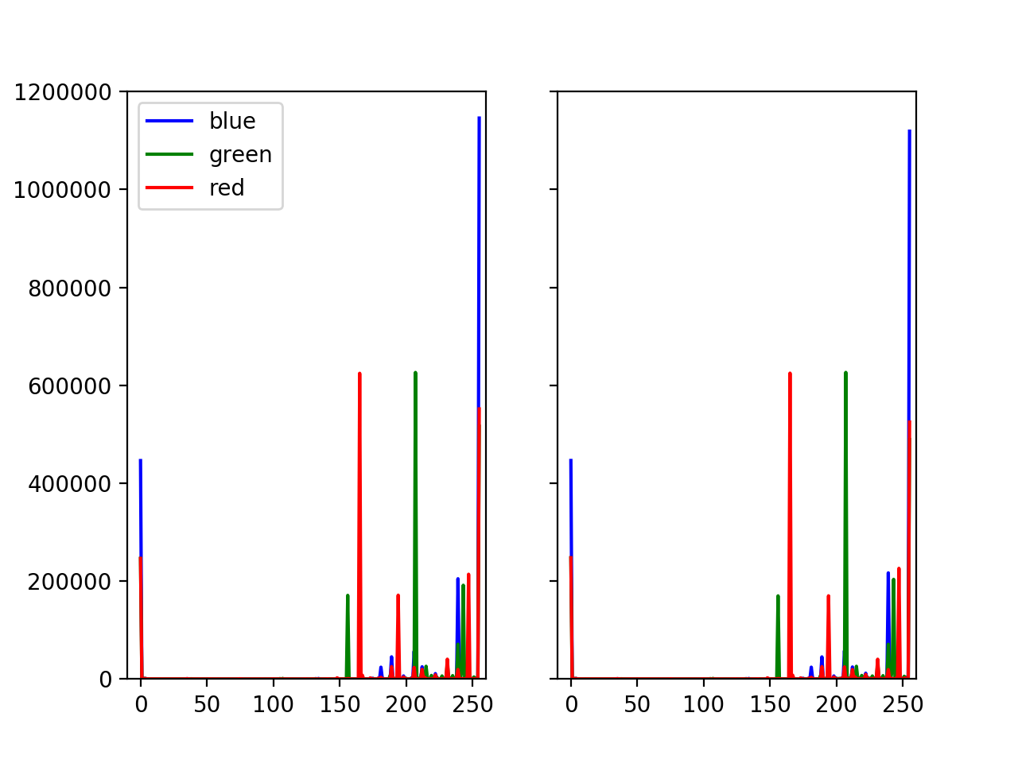
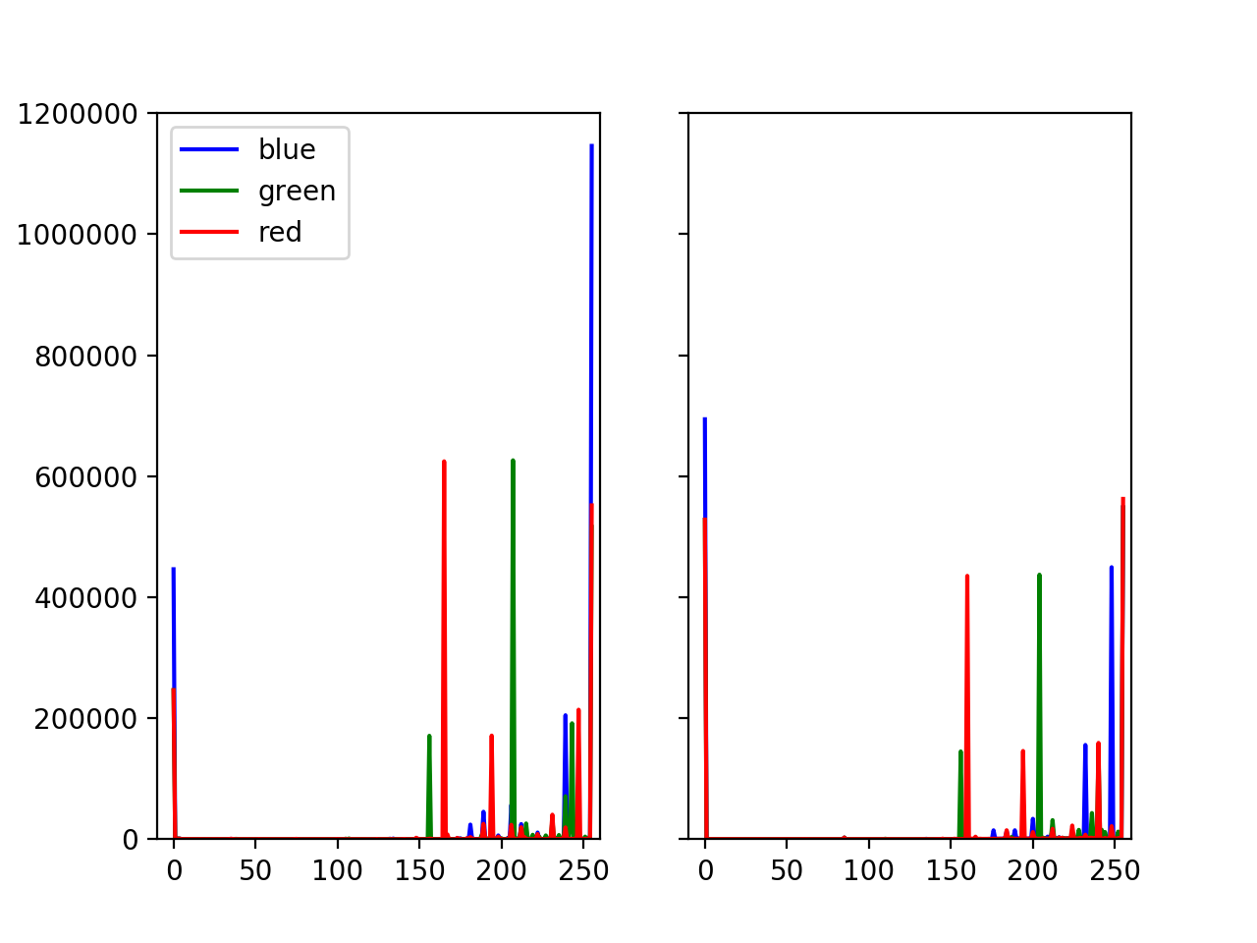
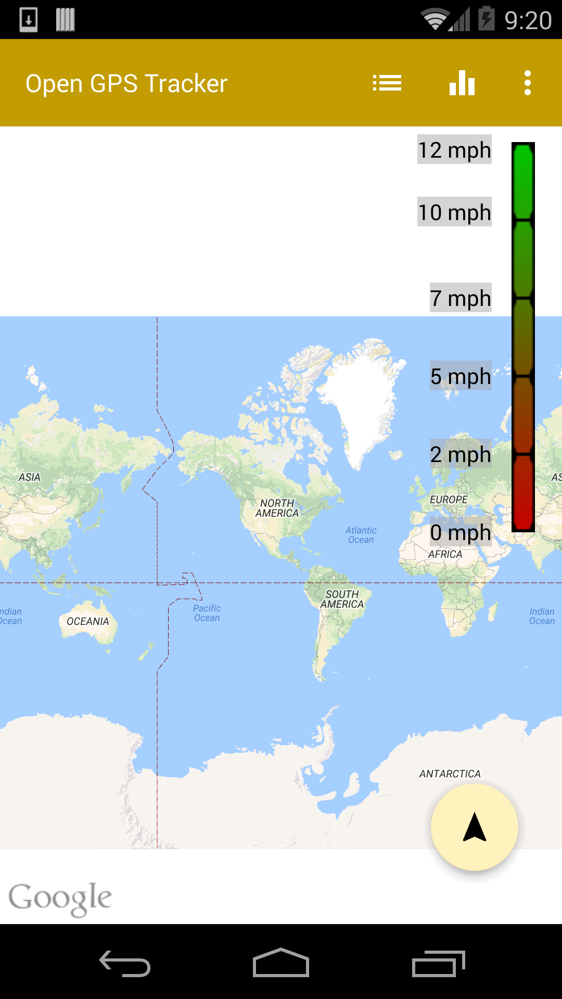
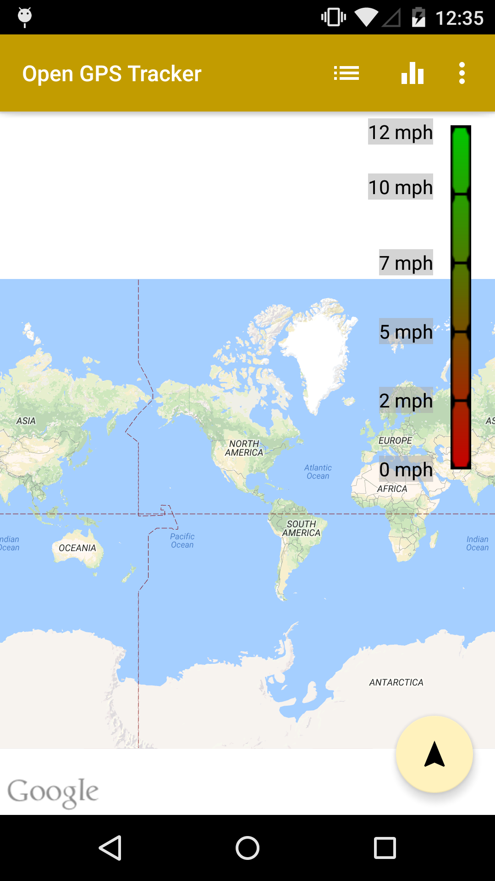
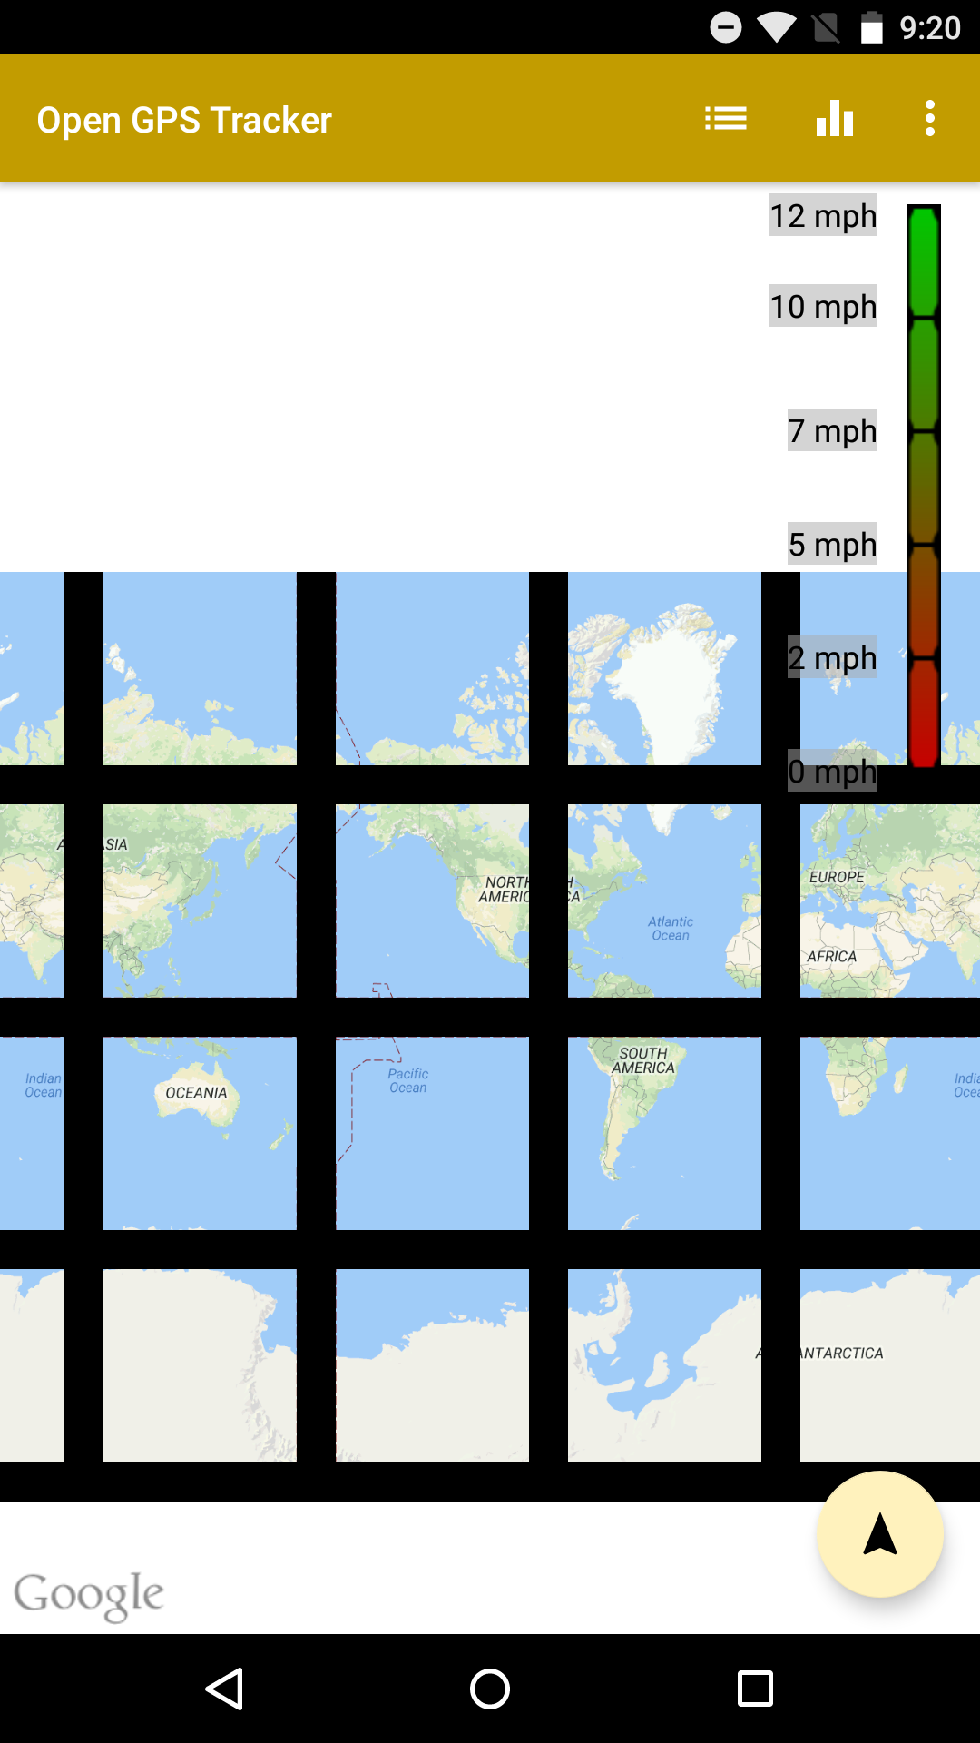
Example of Visual Inspection
Color Histogram
Version 4
Version 6
Version 5
Compare with | Color Histogram | Feature Matching
Version 5 | 3.4 %
Version 6 | 56.02 %
Version 4 (leader)
Version 5
Version 6
Open GPS Tracker App
Difference Percentages

Slide 24
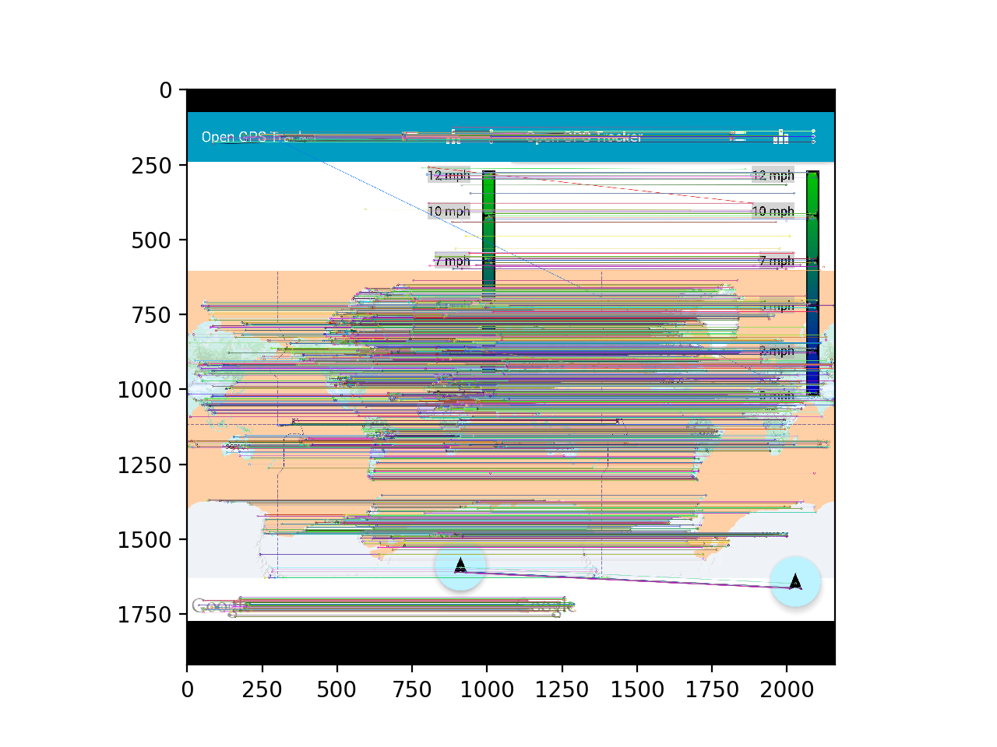
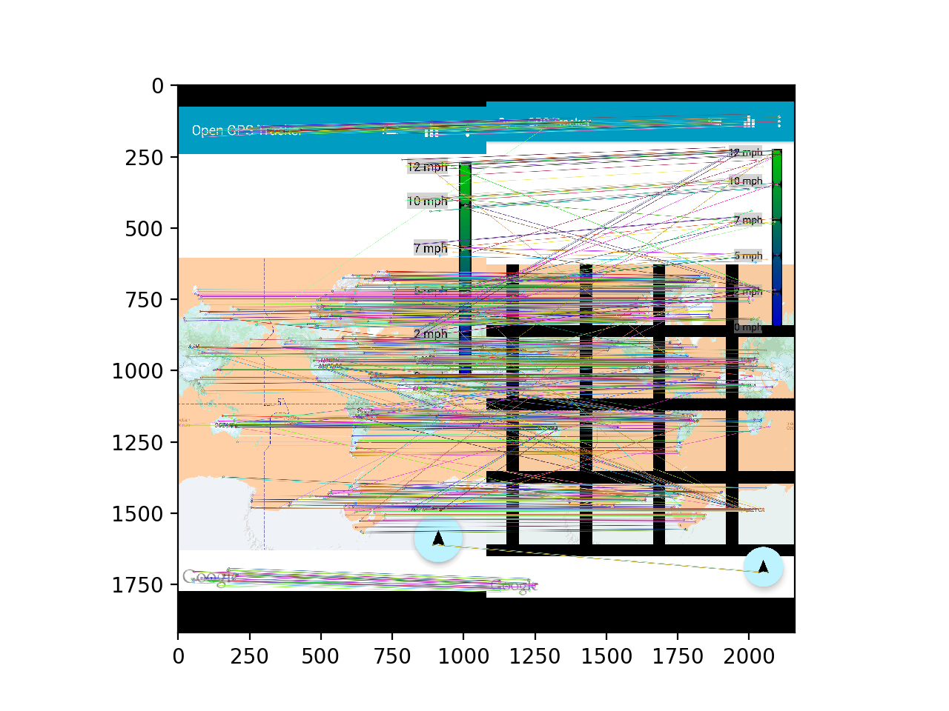
Example of Visual Inspection
Feature Matching
Version 4
Version 5
Version 6
Compare with | Color Histogram | Feature Matching
Version 5 | 3.4 % | 11.84 %
Version 6 | 56.02 % | 65.01 %
Version 4 (leader)
Version 5
Version 6
Open GPS Tracker App
Difference Percentages
Notes:
Threshold used: 30%
Checks one of the calculations (color histogram & feature matching) exceeds the threshold

Slide 25
Evaluation
How effective is Mimic programming model?
Compare with UI Automator (Android baseline testing mechanism)
How correctly does Mimic catch compatibility issues?
UI compatibility issues
(More questions are answered in our paper)

Slide 26
How effective is Mimic programming model?
Compare with UI Automator (Android baseline testing mechanism)
Implement two strategies
Randomized testing
Sequential testing
Testing Logic | Framework | LoC | Testing Environment
Randomized testing | UI Automator | 178 | Non-automated
Sequential testing | UI Automator | 199 | Non-automated
Randomized testing | Mimic | 11 | Automated
Sequential testing | Mimic | 13 | Automated
Environment Setting
Platform installation
App Installation
Device Management
Device status monitor
Log capture
About 15x less

Slide 27
2. Forward Compatibility Testing
Randomly chose 100 apps targeting Android API 19 (leader) from popular 1000 real apps
Ran the selected 100 apps across four Android API versions (19, 21, 22, and 23)
Used three different methods: Base-random, Mimic-random, and Mimic-sequence
App Name | Android API Version |  |  |  |  |  |  |  |  |  |  |  | Exception Type
 | Base-random |  |  |  | Mimic-random |  |  |  | Mimic-sequence
 | 19* | 21 | 22 | 23 | 19* | 21 | 22 | 23 | 19* | 21 | 22 | 23
Yelp |  |  |  | ✓ | ✓ | ✓ | ✓ | ✓ | ✓ | ✓ | ✓ | ✓ | NetworkOnMainThreadException
College Sports Live |  | ✓ |  | ✓ |  | ✓ | ✓ | ✓ |  | ✓ | ✓ | ✓ | NullPointerException
Home Exercise Workouts |  |  |  | ✓ |  | ✓ | ✓ | ✓ |  | ✓ | ✓ | ✓ | NoSuchMethodError
Fast Cleaner |  | ✓ |  |  |  |  |  |  |  | ✓ | ✓ | ✓ | NullPointerException
Photo Lab |  |  |  |  |  | ✓ | ✓ | ✓ |  | ✓ | ✓ | ✓ | NullPointerException
Weather Kitty |  |  |  |  |  |  | ✓ | ✓ |  |  | ✓ | ✓ | NoSuchMethodError
IP Webcam |  |  |  | ✓ |  |  |  |  |  |  |  | ✓ | Mishandling runtime permissions
CCleaner |  |  |  |  |  |  |  |  |  |  |  | ✓ | Mishandling runtime permissions
Livestream |  |  |  | ✓ |  |  |  | ✓ |  |  |  | ✓ | NoSuchMethodErro
More errors have been discovered by Mimic

Slide 28
3. Backward Compatibility Testing
Randomly chose 100 apps targeting Android API 23 (leader) from popular 1000 real apps
Ran the selected 100 apps across four Android API versions (19, 21, 22, and 23)
Used three different methods: Base-random, Mimic-random, and Mimic-sequence
App Name | Android API Version |  |  |  |  |  |  |  |  |  |  |  | Exception Type
 | Base-random |  |  |  | Mimic-random |  |  |  | Mimic-sequence
 | 23* | 22 | 21 | 19 | 23* | 22 | 21 | 19 | 23* | 22 | 21 | 19
truTV |  | ✓ |  |  |  |  |  |  |  | ✓ | ✓ | ✓ | NullPointerException
Whitetail Deer Calls |  |  |  | ✓ |  | ✓ | ✓ | ✓ |  | ✓ | ✓ | ✓ | NoSuchMethodError
Cheapﬂights |  |  |  |  |  |  |  |  |  | ✓ | ✓ | ✓ | NoSuchMethodError
Map of NYC Subway |  |  |  | ✓ |  |  | ✓ | ✓ |  |  | ✓ | ✓ | NoSuchMethodError
WatchESPN |  |  | ✓ |  |  |  | ✓ |  |  |  | ✓ |  | NullPointerException
Collage Maker |  |  |  | ✓ |  |  |  |  |  |  |  | ✓ | NoSuchMethodError
More errors have been discovered by Mimic

Slide 29
How correctly does Mimic catch compatibility issues?
1. App version compatibility issues
Downloaded 2,097 apps (top 100 in each category) from Google Play
Chose 100 apps out of 233 apps (at least two updates in two weeks)
Sequential strategy on Android API version 4.4
App Name | Previous Version | New Version | Exception Type
TD Jakes Sermons | ✓ | ✓ | InﬂateException
Venmo | ✓ | ✓ | IllegalArgumentException
Volume Booster | ✓ | ✓ | SecurityException
Countdown Timer & Stopwatch & Caller ID | ✓ | ✓ | NullPointerException
Wonder Buy | ✓ |  | NullPointerException
Capture exact differences between two versions

Slide 30
4. App Version Compatibility Testing
Downloaded 2,097 apps that are top 100 apps in each category from Google Play
Chose 100 out of 233 apps that have at least two different version updates in two weeks
Labeled: Stable - earlier version, New – updated version
Ran the apps on same Android API version 4.4
Used three different methods: Base-random, Mimic-random, and Mimic-sequence
App Name | Stable Version |  |  | New Version |  |  | Exception Type
 | Base-random | Mimic-random | Mimic-sequence | Base-random | Mimic-random | Mimic-sequence
TD Jakes Sermons | ✓ | ✓ | ✓ | ✓ | ✓ | ✓ | InﬂateException
Venmo |  | ✓ | ✓ |  | ✓ | ✓ | IllegalArgumentException
Volume Booster | capture | ✓ | ✓ |  | ✓ | ✓ | SecurityException
Countdown Timer & Stopwatch & Caller ID |  | ✓ | ✓ |  | ✓ | ✓ | NullPointerException
Wonder Buy |  |  | ✓ |  |  |  | NullPointerException
More errors have been discovered by Mimic
Notes:
Follow-the-leader model is the only difference between base and mimic-random (emphasize!)
Better than the individual testing on each device
Column (base-random, mimic-random)
1slide: base-random, mimic-random columns only (follow-the-leader strategy is better – key )
2slide: mimi-sequence from stable and new version(with exhaustive strategy, we could capture the exact differences between two versions whether problem is fixed)

Slide 31
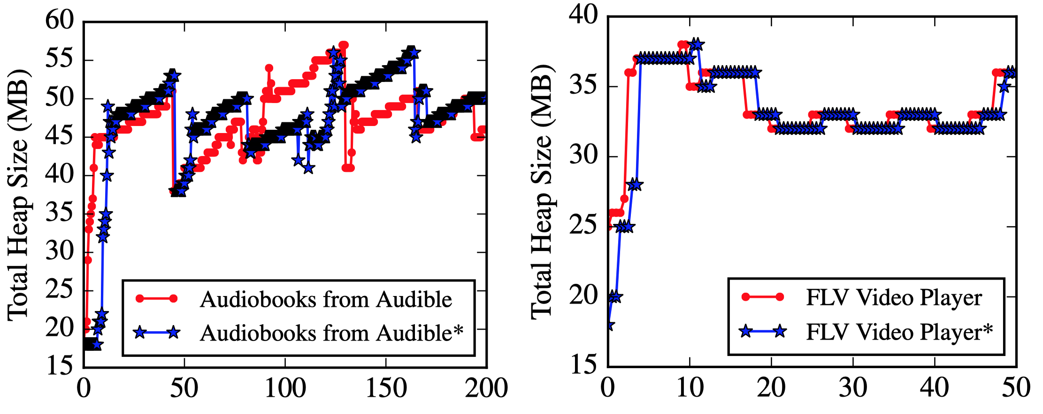
5. Instrumentation Testing
Selected 100 out of 1,200 apps from Reptor (bytecode instrumentation tool enabling API virtualization on Android) data set.
Ran the apps (both non-instrumented and instrumented) on Android API version 4.4
Used two different methods: Mimic-random, and Mimic-sequence
Heap usage comparison
App Name | Non-instrumented Version |  | Instrumented Version |  | Exception Type
 | Mimic-random | Mimic-sequence | Mimic-random | Mimic-sequence
GasBuddy | ✓ | ✓ | ✓ | ✓ | ClassCastException
Stamp and Draw Paint 2 | ✓ | ✓ | ✓ | ✓ | ClassCastException
Big 5 Personality Test |  |  | ✓ | ✓ | AssertionError
Text To Speech Reader |  |  | ✓ | ✓ | AssertionError
Gun Vault |  |  |  | ✓ | AssertionError
Street Art 3D |  |  | ✓ | ✓ | NullPointerException
Viaplay GameCenter-F |  |  | ✓ | ✓ | NullPointerException
Q Recharge |  |  | ✓ | ✓ | NullPointerException
Funny Face Photo Camera |  |  |  | ✓ | NullPointerException
Japan Ofﬂine Map Hotels Cars |  |  |  | ✓ | NullPointerException
Mimic successfully found out various errors
Notes:
Mimic strategy could find errors from even stable versions.
Heap usage comparison using callback onHeapUsageChanged()

Slide 32
How correctly does Mimic catch compatibility issues?
UI compatibility issues
FicFinder – 14 apps that contain verified UI compatibility issues
Used randomnized testing strategy.
U – UI distortion, E – errors
App Name | Category | Bug Type | Results | Device (Android Version)
Open GPS Tracker | Travel & Local | U | ✓ | Nexus 5/6.0.1
ConnectBot | Communication | E | ✓ | Galaxy Nexus (4.1.1)
AnkiDroid | Education | E | ✓ | Galaxy S4 (4.4)
c:geo | Entertainment | E | ✓ | Nexus S (2.3.6)
AnySoftKeyboard | Tools | E | ✓ | Galaxy S4 (4.4)
QKSMS | Communication | E | ✓ | Neuxs 5 (5.1)
BankDroid | Finance | E | ✓ | Galaxy S4 (4.4)
Evercam | Tools | E | ✓ | Nexus S (4.1.2)*
ChatSecure | Communication | U, E | ✓ | Galaxy Nexus (4.2.1)
AntennaPod | Media & Video | U | ✓ | Nexus 5 (5.1)
Brave Android Browser | Personalization | U | ✓ | Nexus 5 (4.4)
IrssiNotiﬁer | Communication | E | ✗
CSipSimple | Communication | U | ✗
Bitcoin Wallet | Finance | E | ✗
Successfully found
reported errors

Slide 33
Conclusion
Mimic
First UI compatibility testing system
Supports automated device management & environment initialization
Provides a programming model
UI specific features – Graph generator & visual inspector
“Follow-the-leader” successfully detects
UI compatibility issues

